Slide 1
Sliding window object detection
Deep Learning

Slide 2
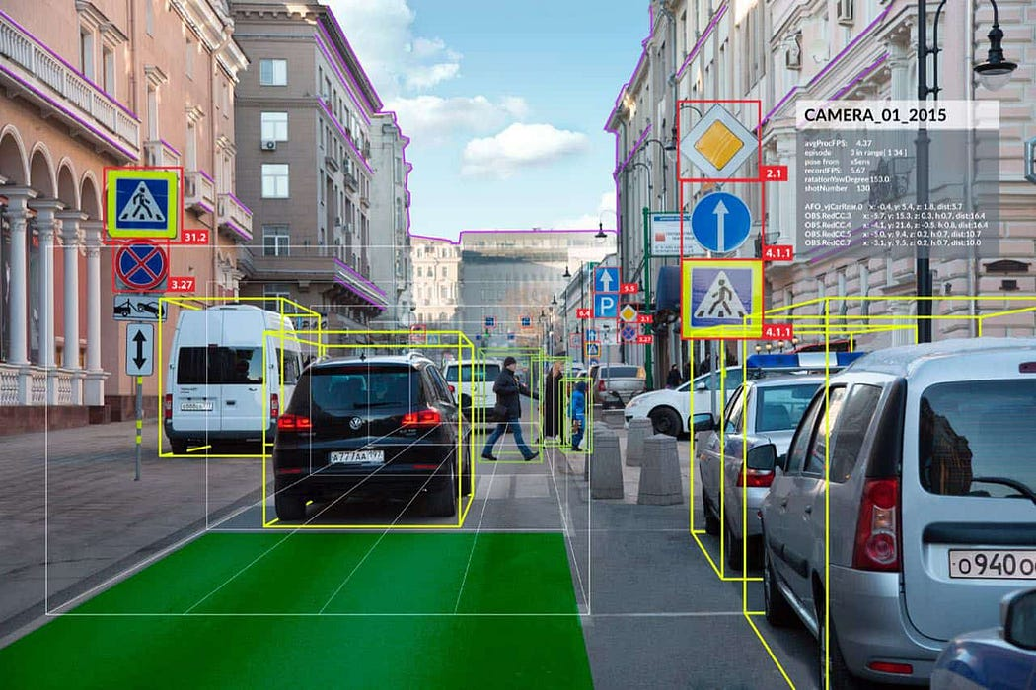
Sliding Window Object Detection

Slide 3
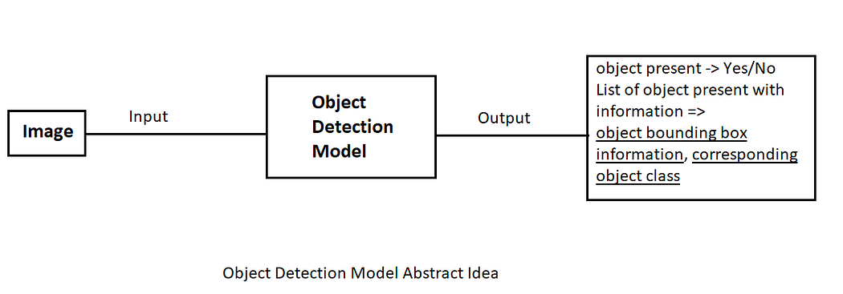
Object Detection Model
Input : Image (with or without objects present)
Output : If objects present, list the object location (bounding box co-ordinates) and corresponding object class.

Slide 4
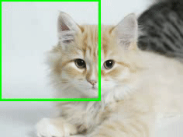
Basic Concept of Object Detection Idea : Sliding Window Object Detection
The idea is to crop the image into multiple segment/grids and run image classification for each cropped images to determine if there is an object present in this cropped image or not.
We can choose a rectangular region with fixed length and fixed height, that will ‘slide’ across left to right and top to bottom, and each time the cropped image will pass to a pre-trained image classifier, that algorithm is called ‘sliding window approach for object detection’.

Slide 5
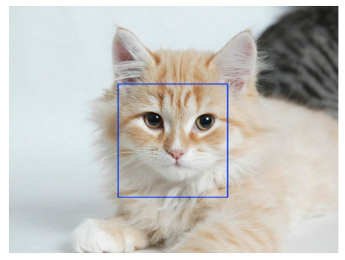
Steps for Object Detection Sliding Window Approach
Consider an image as input.
Select a window size (preferably much smaller than the actual image size).
Crop image as window set on actual image, and pass that cropped image portion to the image classifier and have the prediction output for that region.
Keep on sliding the window and pass the cropped images into image classifier.
At the end, there will be a set of cropped regions which have some classified object.
Cat face detected on the window

Slide 6
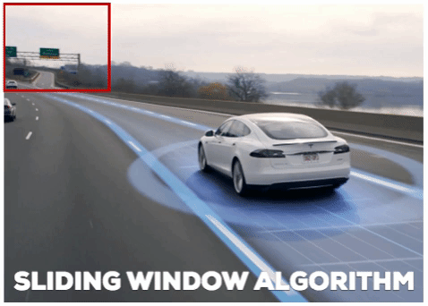
Inaccurate Bounding Box for the detected object

Slide 7
R-CNN – Region-Based Convolutional Neural Networks
Deep Learning

Slide 8
Introduction to R-CNN
R-CNN (Region-based Convolutional Neural Network) was introduced by Ross Girshick et al. in 2014.
R-CNN revolutionized object detection by combining the strengths of region proposal algorithms and deep learning, leading to remarkable improvements in detection accuracy and efficiency.
This approach utilizes a selective search algorithm to generate approximately 2,000 region proposals, which are then processed through a Convolutional Neural Network (CNN) to extract features.
These features are classified using a Support Vector Machine (SVM), while a bounding box regressor is employed to improve localization accuracy.

Slide 9
R-CNN
R-CNN identifies and localizes objects in images by proposing Regions of Interest (RoIs) and classifying them through the CNN.
The object detection framework starts with an input image containing potential objects and employs a Region Proposal Network (RPN), like Selective Search, to generate bounding boxes likely to contain objects.
Each proposed region is resized and fed into a pre-trained CNN, such as AlexNet or VGG16, to extract feature representations.
These features are then classified by the SVM into predefined categories or designated as background. To refine localization further, a bounding box regression model adjusts the coordinates of each box, aligning them more closely with the actual object boundaries.

Slide 10
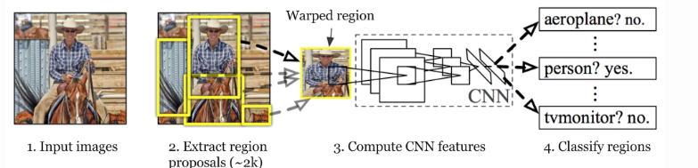
R-CNN architecture

Slide 11
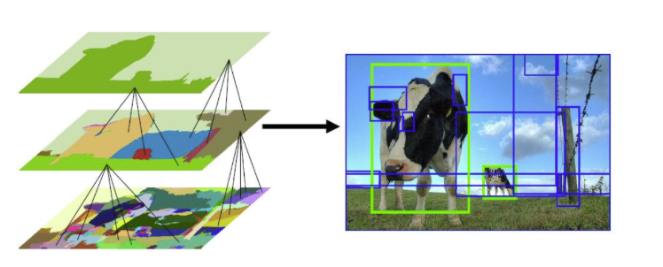
Region Proposals

Slide 12
Selective Search
Selective Search is a greedy algorithm that generates region proposals by combining smaller segmented regions.
Algorithm Steps:
Generate Initial Segmentation: The algorithm starts by performing an initial sub-segmentation of the input image.
Combine Similar Regions: It then recursively combines similar bounding boxes into larger ones. Similarities are evaluated based on factors such as color, texture, and region size.
Generate Region Proposals: Finally, these larger bounding boxes are used to create region proposals for object detection.

Slide 13
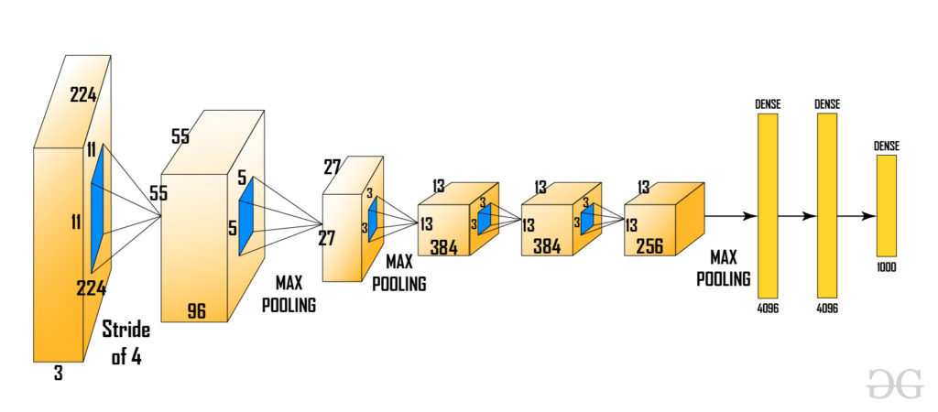
Input Preparation in R-CNN
After generating the region proposals, these regions are warped into a uniform square shape to match the input dimensions required by the CNN model.
Pre-trained AlexNet model, which was considered the state-of-the-art CNN for image classification at the time.

Slide 14
Input Preparation in R-CNN
The input size for AlexNet is (227, 227, 3), meaning each input image must be resized to these dimensions. Consequently, whether the region proposals are small or large, they need to be adjusted accordingly to fit the specified input size.
From the above architecture, we remove the final softmax layer to obtain a (1, 4096) feature vector. This feature vector is then fed into both the Support Vector Machine (SVM) for classification and the bounding box regressor for improved localization.

Slide 15
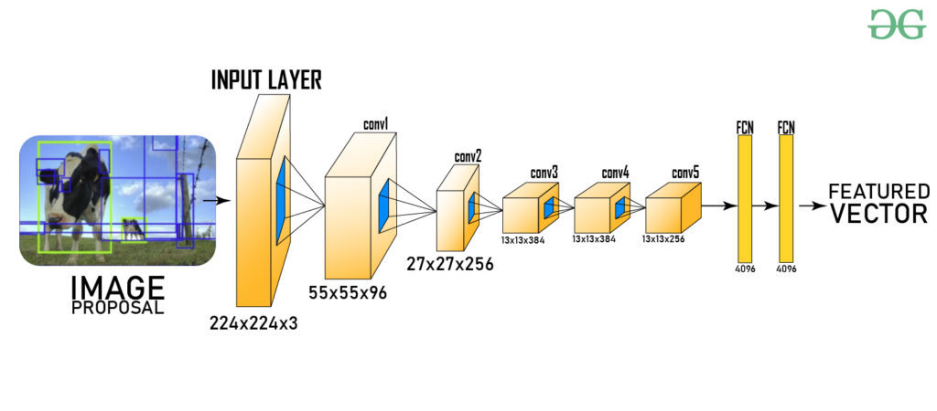
Input Preparation in R-CNN

Slide 16
SVM (Support Vector Machine)
The feature vector generated by the CNN is then utilized by a binary Support Vector Machine (SVM), which is trained independently for each class.
This SVM model takes the feature vector produced by the previous CNN architecture and outputs a confidence score indicating the likelihood of an object being present in that region.
However, a challenge arises during the training process with the SVM: it requires the AlexNet feature vectors for each class.
As a result, we cannot train AlexNet and the SVM independently and in parallel.

Slide 17
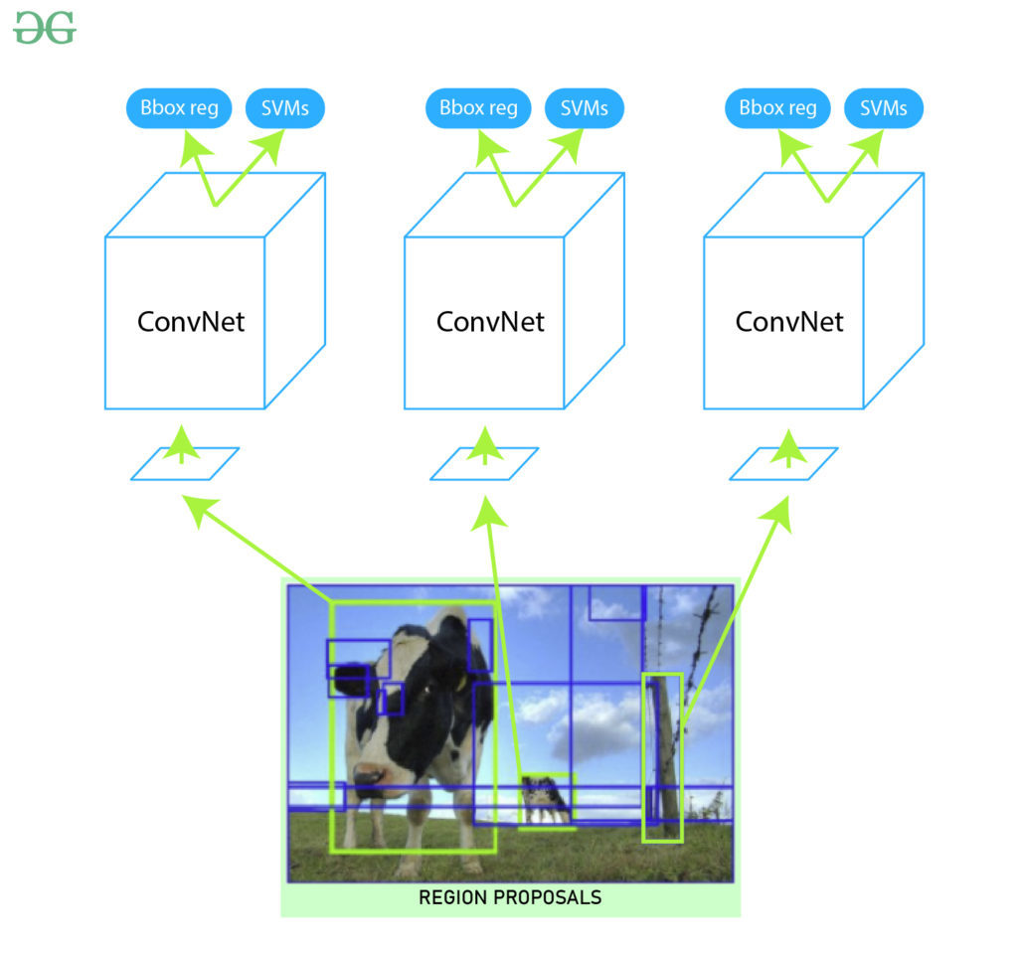
Bounding Box Regressor

